Slide 1
M2M

Slide 2
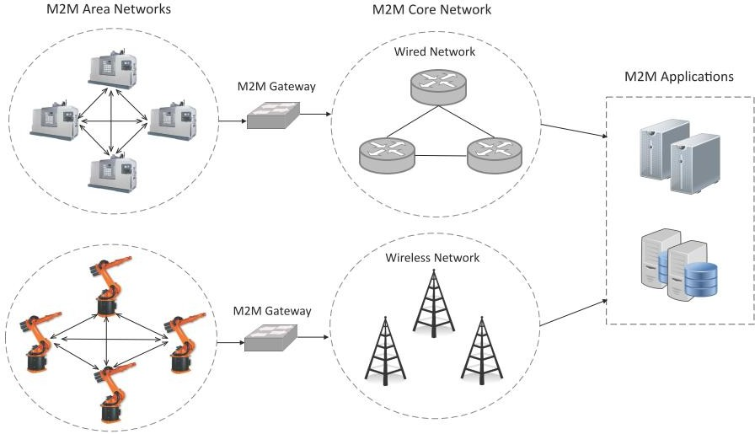
Machine-to-Machine (M2M)
Machine-to-Machine (M2M) refers to networking of machines (or devices) for the purpose of remote monitoring and control and data exchange.

Slide 3
M2M system
Each machine in embeds a smart device
Device senses the data or status of the machine
Performs the computation and communication functions
A device communicates via wired or wireless systems
3

Slide 4
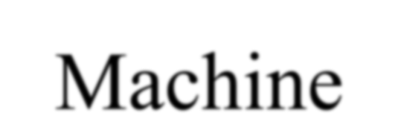
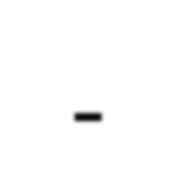
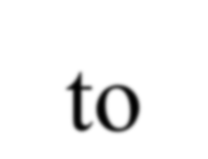
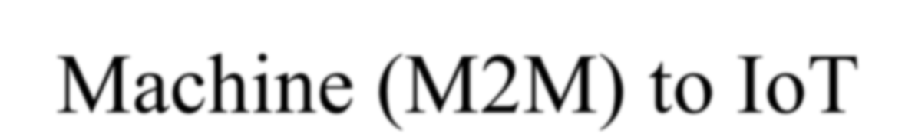
Technology closely relates to IoT which use smart devices to collect data that is transmitted via the Internet to other devices.
Close differences lies in M2M uses for device to device communication also for coordinated monitoring and control purposes
4

Slide 5
M2M Application Areas
Connected Cars for Safety
Remote Monitoring
ATMs/Point of Sales Terminal Connected for centralized Security
5

Slide 6
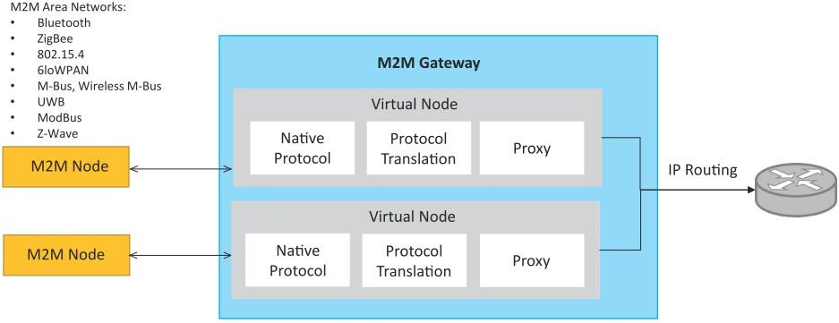
M2M gateway
Since non-IP based protocols are used within M2M area networks, the M2M nodes within one network cannot communicate with nodes in an external network.
To enable the communication between remote M2M area networks, M2M gateways are used.

Slide 7
Difference between IoT and M2M
Communication Protocols
M2M and IoT can differ in how the communication between the machines or devices happens.
M2M uses either proprietary or non-IP based communication protocols for communication within the M2M area networks.
Machines in M2M vs Things in IoT
The "Things" in IoT refers to physical objects that have unique identifiers and can sense and communicate with their external environment (and user applications) or their internal physical states.
M2M systems, in contrast to IoT, typically have homogeneous machine types within an M2M area network.

Slide 8
Difference between IoT and M2M
Hardware vs Software Emphasis
While the emphasis of M2M is more on hardware with embedded modules, the emphasis of IoT is more on software.
Data Collection & Analysis
M2M data is collected in point solutions and often in on-premises storage infrastructure.
In contrast to M2M, the data in IoT is collected in the cloud (can be public, private or hybrid cloud).
Applications
M2M data is collected in point solutions and can be accessed by on-premises applications such as diagnosis applications, service management applications, and on- premisis enterprise applications.
IoT data is collected in the cloud and can be accessed by cloud applications such as analytics applications, enterprise applications, remote diagnosis and management applications, etc.

Slide 9
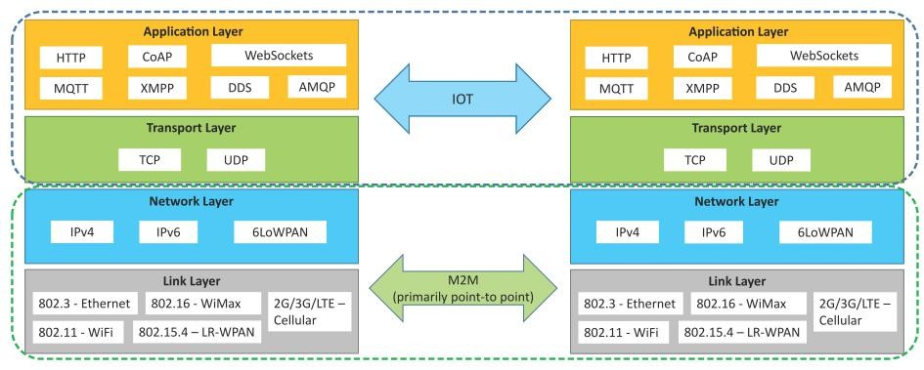
Communication in IoT vs M2M

Slide 10
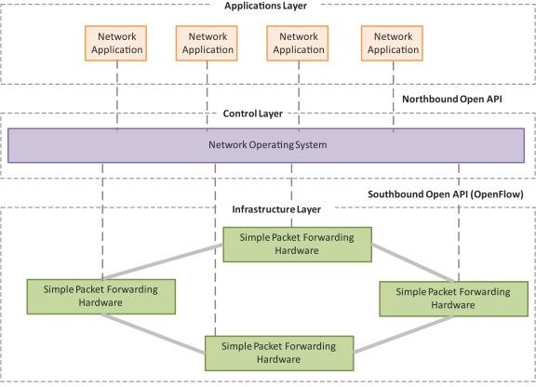
SDN
Software-Defined Networking (SDN) is a networking architecture that separates the control plane from the data plane and centralizes the network controller.
Software-based SDN controllers maintain a unified view of the network and make confi guration, management and provisioning simpler.
The underlying infrastructure in SDN uses simple packet forwarding hardware as opposed to specialized hardware in conventional networks.

Slide 11
Key elements of SDN
Centralized Network Controller
With decoupled control and data planes and centralized network controller, the network administrators can rapidly configure the network.
Programmable Open APIs
SDN architecture supports programmable open APIs for interface between the SDN application and control layers
Standard Communication Interface (OpenFlow)
SDN architecture uses a standard communication interface between the control and infrastructure layers (Southbound interface).
OpenFlow, which is defined by the Open Networking Foundation (ONF) is the broadly accepted SDN protocol for the Southbound interface.

Slide 12
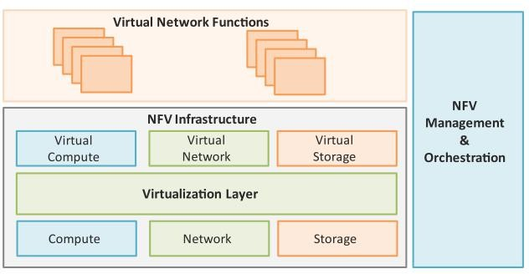
NFV
Network Function Virtualization (NFV) is a technology that leverages virtualization to consolidate the heterogeneous network devices onto industry standard high volume servers, switches and storage.
NFV is complementary to SDN as NFV can provide the infrastructure on which SDN can run.

Slide 13
Key elements of NFV
Virtualized Network Function (VNF):
VNF is a software implementation of a network function which is capable of running over the NFV Infrastructure (NFVI).
NFV Infrastructure (NFVI):
NFVI includes compute, network and storage resources that are virtualized.
NFV Management and Orchestration:
NFV Management and Orchestration focuses on all virtualization-specific management tasks and covers the orchestration and life-cycle management of physical and/or software resources that support the infrastructure virtualization, and the life-cycle management of VNFs.

Slide 14
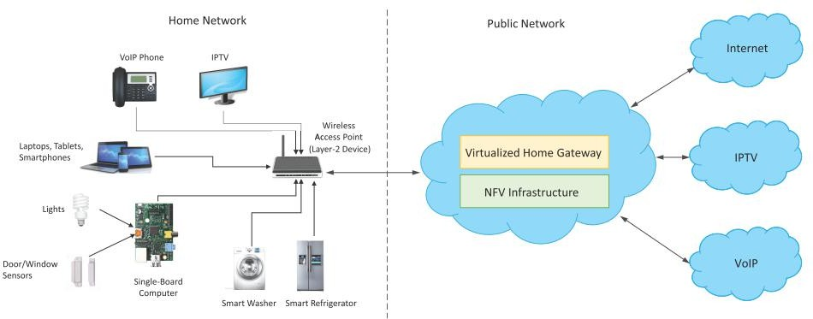
NFV Use Case
NFV can be used to virtualize the Home Gateway. The NFV infrastructure in the cloud hosts a virtualized Home Gateway. The virtualized gateway provides private IP addresses to the devices in the home. The virtualized gateway also connects to network services such as VoIP and IPTV.

Slide 15
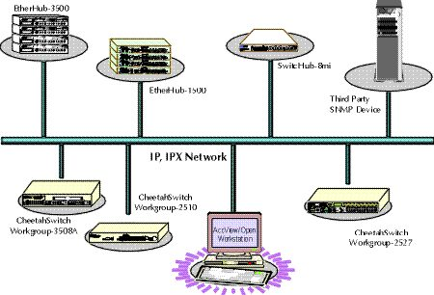
Simple Network Management Protocol (SNMP)
What is it?
A Protocol that Facilitates the exchange of management information
between network devices.
Why was it developed?
To control and monitor status of network devices
How is it beneficial?
Enables network administrators to:
Manage network performance
Find and solve network problems
Plan for network growth

Slide 16
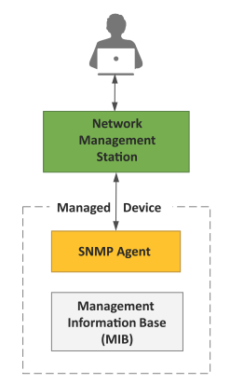
SNMP Basic Components
SNMP is a well-known and widely used network management protocol that allows monitoring and configuration of network devices such as routers, switches, servers, printers, etc.
Network Management station
Collects and stores management information, and makes this information available to NMS using SNMP
Could be a work station or PC
Network Management System (NMS)
Executes applications that monitor and control managed devices
Agent
A network-management software module that resides in a managed device
Management Information Base (MIB)
Used by both the manager and the agent to store and exchange management information

Slide 17
NMS
Network Management Architecture
User Interface
Management Station
Network Management Application
SNMP
SNMP
SNMP
AGENT
AGENT
AGENT
MIB
MIB
MIB
Managed Devices
Router
Host
Printer

Slide 18
How SNMP Works
Get-request
Get-next-request
Set-request
MIB
SNMP Agent
Get-response
Network Management Station
traps
Get-request: Request value of variable.
Get-next-request: Request the value of next variable (like a table).
Set-request: update one or more variables (for reconfiguration).
Get-response: agents sends a reply to manager.
Traps: agent notifies manager about an abnormal situation.

Slide 19
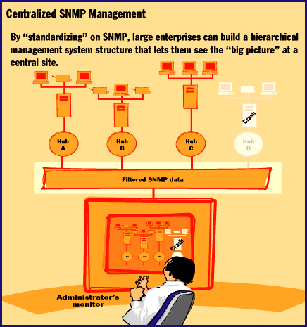
With a Network Management System, you can monitor a large network from a central console.

Slide 20
LIMITATIONS :
SNMP is stateless in nature and each SNMP request contains all the information required to process the request. The application needs to be intelligent to manage the device.
SNMP is a connectionless protocol which uses UDP as the transport protocol, making it unreliable as there is no support for acknowledgement of requests.
MIBs often lack writable objects without which device configuration is not possible using SNMP.
It is difficult to differentiate between configuration and state data in MIBs.
Retrieving the current configuration from a device can be difficult with SNMP.
Earlier versions of SNMP did not have strong security features
SNMP SECURITY :
Lacks authentication. Vulnerable to the variety of security threats.
Vulnerable to masquerading, modification of information, time modifications, message sequencing and disclosures.
Message sequence and timing modifications occurs when an entity who is unauthorized reorders, delays, or copies and later replays a message generated by an authorized entity.

Slide 21
Network Operator Requirements:
Depending on the specific devices and applications involved, an IoT network may require:
The ability to connect large numbers of heterogeneous IoT elements
High reliability
Real-time awareness with low latency
The ability to Secure all traffic flows
Programmability for application customization
Traffic monitoring and management at the device level
Low cost connectivity for large number of devices/sensors

Slide 22
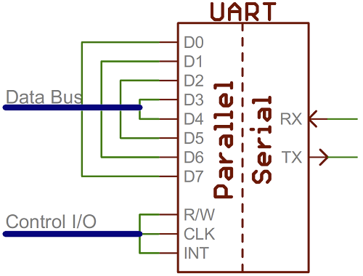
UART
Universal Asynchronous Receiver/Transmitter
Hardware that translates between parallel and serial forms
Commonly used in conjunction with communication standards such as EIA, RS-232, RS-422 or RS-485

Slide 23

Protocol
Each character is sent as
a logic low start bit
a configurable number of data bits (usually 7 or 8, sometimes 5)
an optional parity bit
one or more logic high stop bits
with a particular bit timing (“baud”)

Slide 24
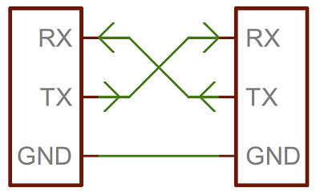
UART Hardware Connection

Slide 25
Security Risks for using UART
Internet of Things (IoT) devices may support UART to send and transmit signals wirelessly. Manufacturers install UART interfaces on IoT boards to review serial console logs and complete any debug activity required. Since UART interacts with IoT devices, it is possible for hackers to infiltrate the UART shell and root shell. Shells manage user interaction with a computing system through an input-output interface. Hence, we have to take UART Security into consideration
If a cybercriminal gains access to the root shell, they can cause detriment to an organization. For example, hackers may:
Infiltrate and reverse engineer firmware to see how to exploit it further
Gain access to sensitive information such as certificates or API keys
Examine communication protocols for vulnerabilities
Target user devices, including company users and clients

Slide 26
Serial Peripheral Interconnect (SPI)
Another kind of serial protocol in embedded systems (proposed by Motorola)
Four-wire protocol
SCLK — Serial Clock
MOSI/SIMO — Master Output, Slave Input
MISO/SOMI — Master Input, Slave Output
SS — Slave Select
Single master device and with one or more slave devices
Higher throughput than I2C and can do “stream transfers”
No arbitration required
But
Requires more pins
Has no hardware flow control
No slave acknowledgment (master could be talking to thin air and not even know it)
Notes:
Better suited for “data streams”, i.e. ADC converters
Full duplex capability, i.e. communication between a codec and digital signal processor

Slide 27
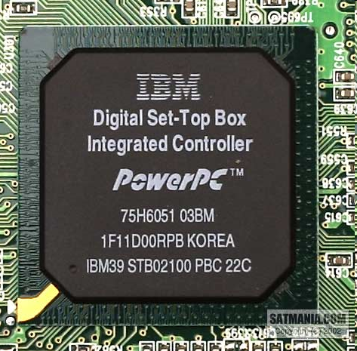
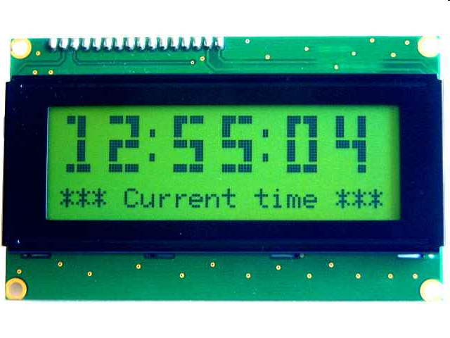
What is SPI?
Serial Bus protocol
Fast, Easy to use, Simple
Everyone supports it

Slide 28
SPI Basics
A communication protocol using 4 wires
Also known as a 4 wire bus
Used to communicate across small distances
Multiple Slaves, Single Master
Synchronized

Slide 29
SPI Capabilities
Always Full Duplex
Communicating in two directions at the same time
Transmission need not be meaningful
Multiple Mbps transmission speed
Transfers data in 4 to 16 bit characters
Multiple slaves
Daisy-chaining possible

Slide 30
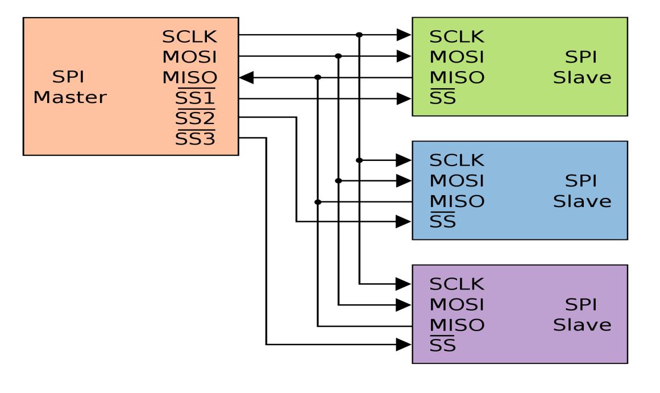
SPI Protocol
Wires:
Master Out Slave In (MOSI)
Master In Slave Out (MISO)
System Clock (SCLK)
Slave Select 1…N
Master Set Slave Select low
Master Generates Clock
Shift registers shift in and out data

Slide 31
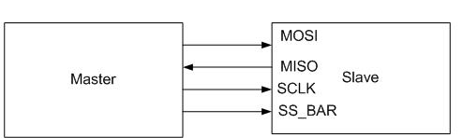
SPI Wires in Detail
MOSI – Carries data out of Master to Slave
MISO – Carries data from Slave to Master
Both signals happen for every transmission
SS_BAR – Unique line to select a slave
SCLK – Master produced clock to synchronize data transfer

Slide 32
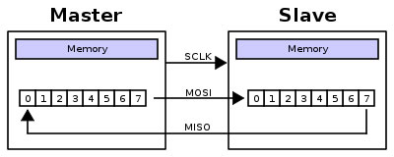
SPI uses a “shift register” model of communications
Master shifts out data to Slave, and shifts in data from Slave
http://upload.wikimedia.org/wikipedia/commons/thumb/b/bb/SPI_8-bit_circular_transfer.svg/400px-SPI_8-bit_circular_transfer.svg.png

Slide 33
Possible Attack Scenarios
In an embedded device, the SPI protocol is used to communicate with various peripherals on the device. It could be sensors, control devices, LCD, SD Card, EEPROM, Flash memory, etc. If an attacker gets access to the device hardware, there are possibilities that he may find the SPI device as an attack surface on the hardware.
Sniffing the communication between an SPI device like sensors, controlling device, memory chip, etc. and the controller/processor.
Extracting the firmware/sensitive info from SPI memory chips.
Patching the firmware in the SPI flash memory chip.
Measures that can mitigate the attacks
Encrypt data on the memory chip to prevent leakage of sensitive info.
Do not hardcode sensitive data on the memory chips.
Store encrypted firmware/data
Physical hardening and protection of chips

Slide 34
What is I²C
The name stands for “Inter - Integrated Circuit Bus”
A Small Area Network connecting ICs and other electronic systems
Originally intended for operation on one single board / PCB
Synchronous Serial Signal
Two wires carry information between a number of devices
One wire use for the data
One wire used for the clock
Today, a variety of devices are available with I²C Interfaces
Microcontroller, EEPROM, Real-Timer, interface chips, LCD driver, A/D converter

Slide 35
What is I²C used for?
Data transfer between ICs and systems at relatively low rates
“Classic” I²C is rated to 100K bits/second
“Fast Mode” devices support up to 400K bits/second
A “High Speed Mode” is defined for operation up to 3.4M bits/second
Reduces Board Space and Cost By:
Allowing use of ICs with fewer pins and smaller packages
Greatly reducing interconnect complexity
Allowing digitally controlled components to be located close to their point of use

Slide 36
I²C Bus Characteristics
Includes electrical and timing specifications, and an associated bus protocol
Two wire serial data & control bus implemented with the serial data (SDA) and clock (SCL) lines
For reliable operation, a third line is required: Common ground
Unique start and stop condition
Slave selection protocol uses a 7-Bit slave address
The bus specification allows an extension to 10 bits
Bi-directional data transfer
Acknowledgement after each transferred byte
No fixed length of transfer

Slide 37
I²C Bus Characteristics (cont’d)
True multi-master capability
Clock synchronization
Arbitration procedure
Transmission speeds up to 100Khz (classic I2C)
Max. line capacitance of 400pF, approximately 4 meters (12 feet)
Allows series resistor for IC protection
Compatible with different IC technologies

Slide 38
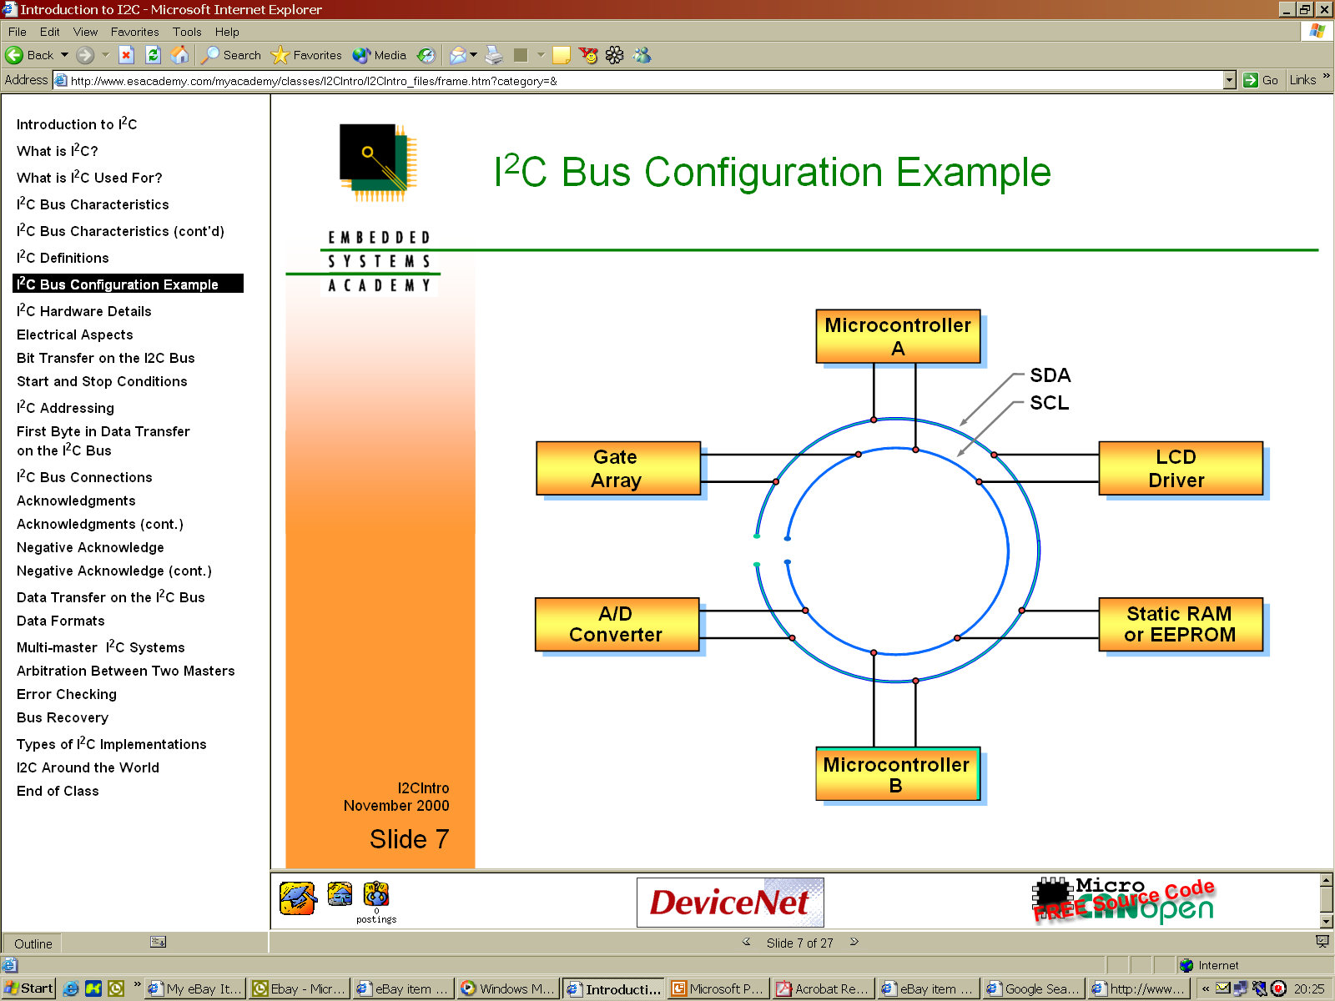
I²C Bus Configuration Example

Slide 39
What measures can make it difficult for an attacker to attack:
Encrypt data on the memory chip to prevent leakage of sensitive info.
Do not hardcode sensitive data on the memory chips.
Store encrypted data
Physical hardening and protection of chips
Protection against clock glitching

Slide 40
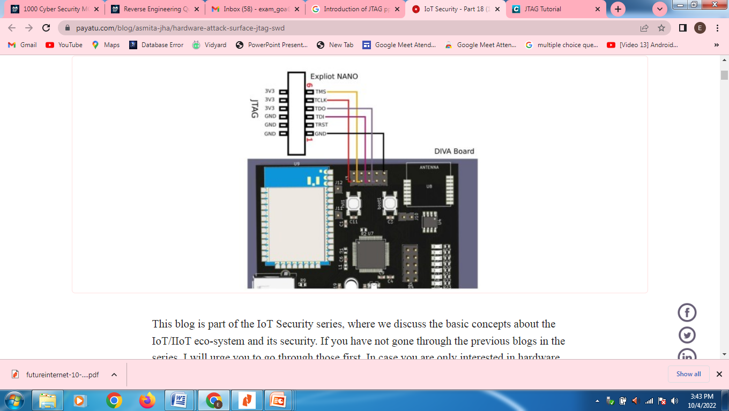
What is JTAG?
JTAG, commonly referred to as boundary-scan and defined by the Institute of Electrical and Electronic Engineers (IEEE) 1149.1, originally began as an integrated method for testing interconnects on printed circuit boards (PCBs) implemented at the integrated circuit (IC) level.
JTAG/boundary-scan presented an elegant solution to this problem: build functionality into the IC to assist in testing assembled electronic systems.
Today, JTAG is used for everything from testing interconnects and functionality on ICs to programming flash memory of systems deployed in the field and everything in-between.
JTAG and its related standards have been and will continue to be extended to address additional challenges in electronic test and manufacturing, including test of 3D ICs and complex, hierarchical systems.
JTAG(Joint Test Action Group)

Slide 41
Possible Attack Scenarios
Getting access to the JTAG/SWD interface on the hardware opens many possibilities for an attacker to break into the device. The following are the possible attack scenarios :
Attackers get access to the controller's internal memory leading to the manipulation of the register values.
Having access to the hardware with the JTAG/SWD interface gives the attacker the possibility of debugging the system.
Another most significant advantage from the attackers' perspective is that the access to JTAG debug interface opens up the possibilities to extract the firmware from the device, patch the firmware, and re-flash the modified vulnerable/malicious firmware back into the device.

